Slide 1
Text Classification using nlp and deep learning
Social Networking Company

Slide 2
V
Slide 1
Data Insights
Problem Statement and Business Overview
Model Building
Metric Evaluation
Data Pre Processing and Feature Engineering
Future Works To be Done
AGENDA

Slide 3
Over View
Objective
Company's Approach and Insight
We are expected to create an analytical and modelling framework to predict the class of each text coming in based on the quantitative and qualitative features.
The have a humongous amount of data which is flowing from various sources and they need to segregate the data into different class so that legit and no legit comments are separated.
As a part of segregating they need machine learning algorithm which can segregate them automatically and avoid the human intervention.

Slide 4


Business Problem
Being anonymous over the internet can sometimes make people say nasty things that they normally would not in real life. Let's filter out the hate from our platforms one comment at a time.
TEXT

Slide 5
DATA PRE-PROCESSING and Feature Engineering
Data Pre-Processing
Feature Engineering
Variables Extraction
Dataset was given with 31634 data points and 4 variables out of which three are target variables.
There were no null values.
Cleaning the text were unnecessary characters are there such as special character symbols and the grammar characters
A new Features are been extracted based on the existing variables.
New Features are:
Count of sentences, Count of words, Count of unique words, Count of letters, Count of Punctuations, Count of Upper Words, Title case words count, Stop words count, Mean length of words
By using the correlation plot between the various extracted variables and the target variables.
We could find the most useful variables.

Slide 6
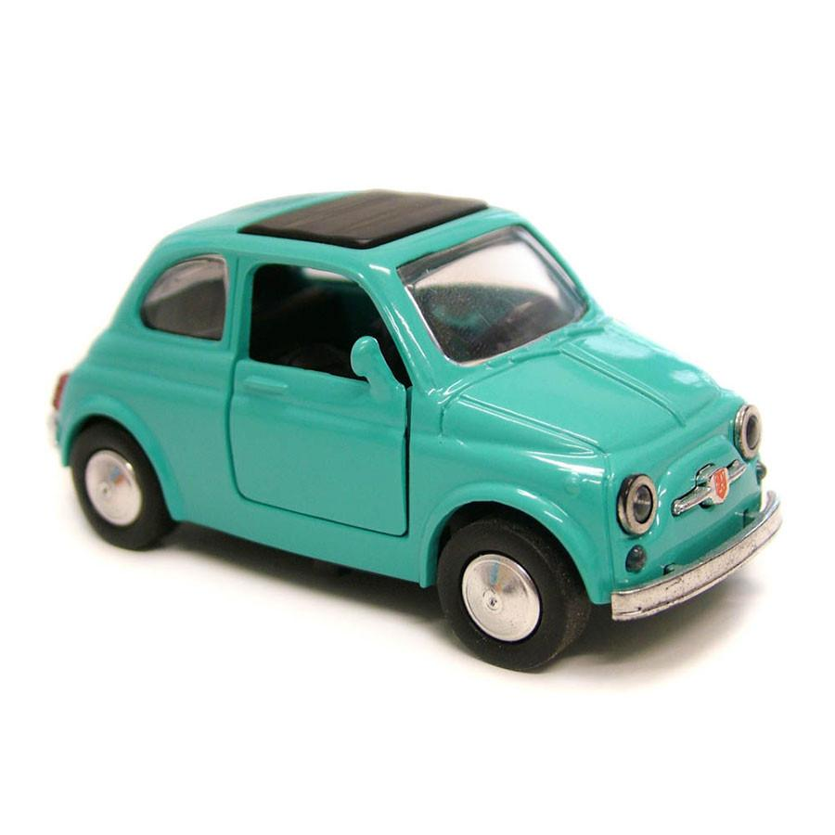

Demo graphs of the Final Data Frame
Initial Data Frame with 31634 data points and 4 feature variables
Feature engineered Data Frame With
31634 by 13 feature variables
Transformation
Omega Dataset Summary:
Total Observations : 31634
Total variables : 13
Split : 80-20
Target Variable : Multi-Labels
Evaluation Metric : Weighted Recall and Accuracy
Customer Centric | Business Centric | Target Variables
TEXT or the Comments | Extracted Features | Obscene, Insulting and Hate

Slide 7
Data Insights

Slide 8
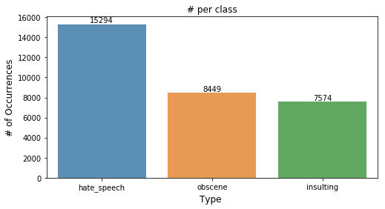
Checking the class imbalance
As to handle the class imbalance we up sampled the data after splitting them into train and test.
Unsampled only the class of obscene and insulting.
And the models didn’t gave a good results.

Slide 9
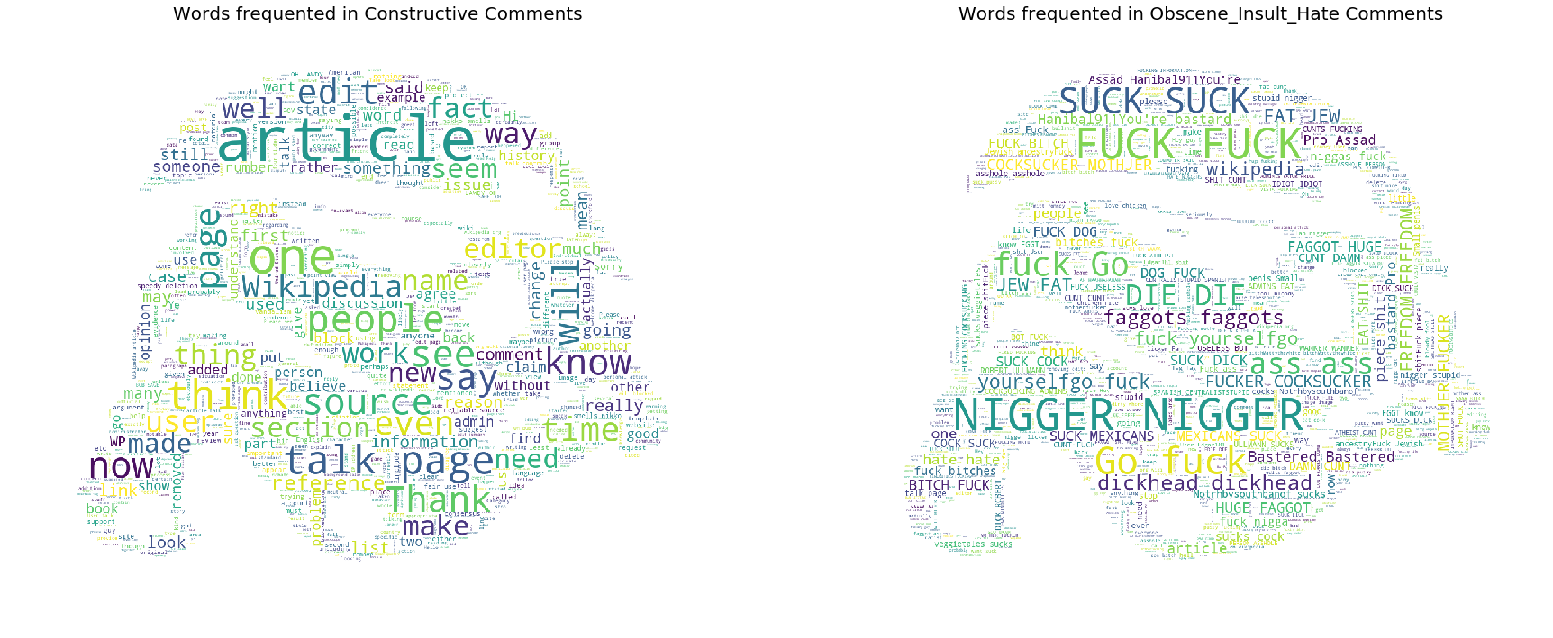
Words Dominating in Constructive and Spam Comments
By using this image we can see that few words are more predominant in one class.

Slide 10
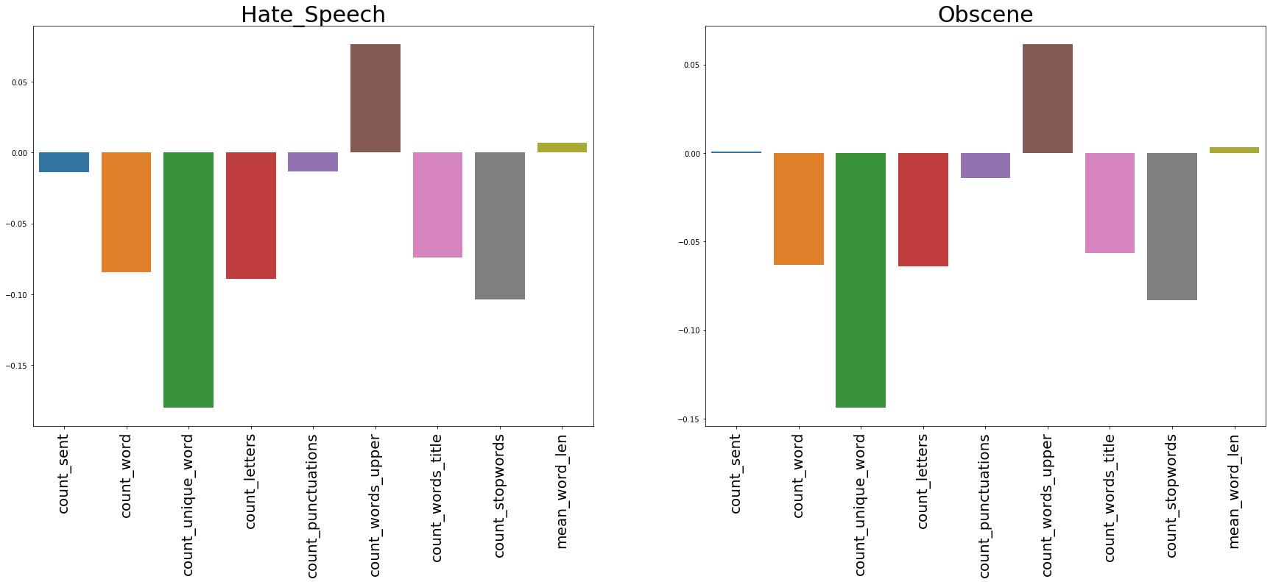
Correlation Between Extracted Features and Target variables with Raw Data

Slide 11
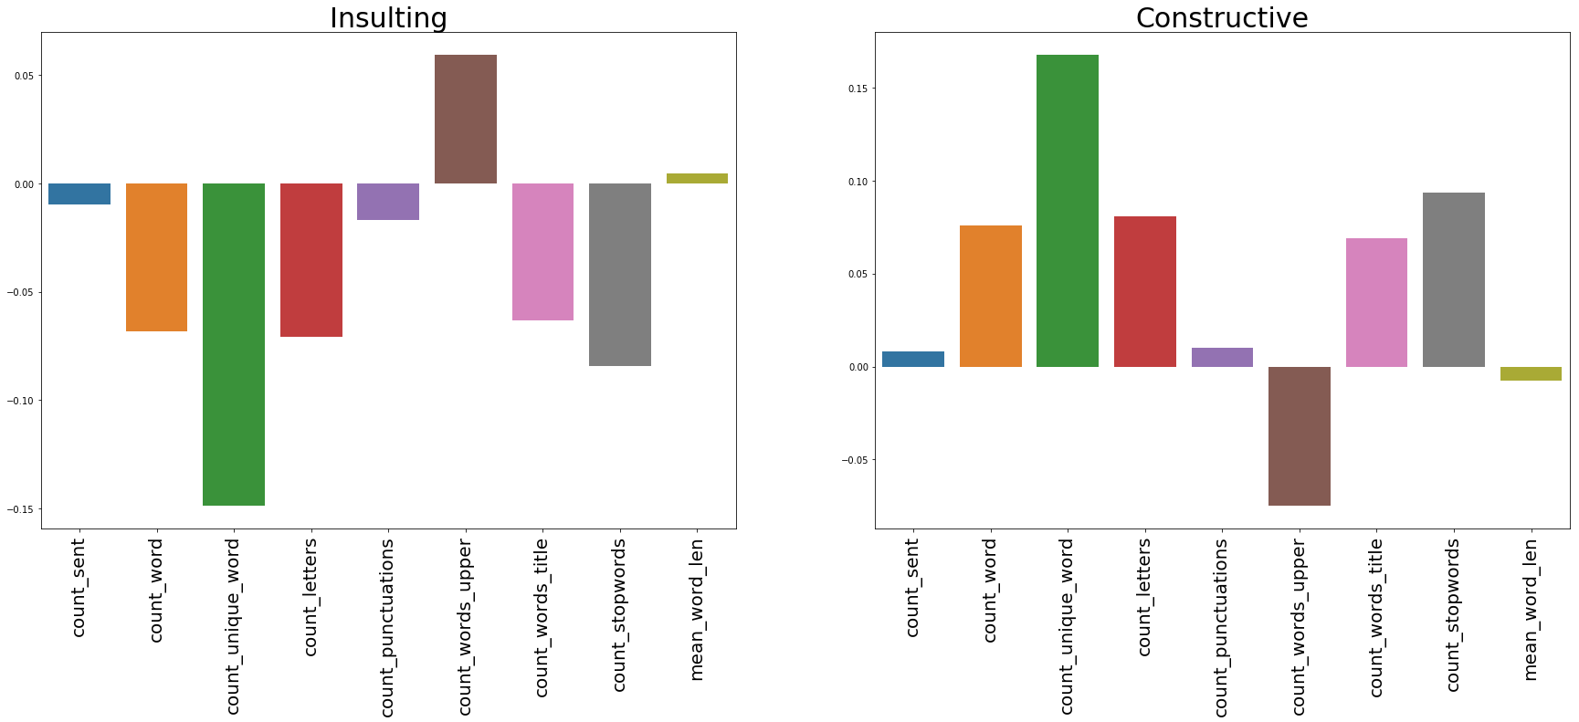

Correlation Between Extracted Features and Target variables with Raw Data
Count of upper words matters a lot in predicting the spam and ham and most of the spam words are having upper case letters.

Slide 12
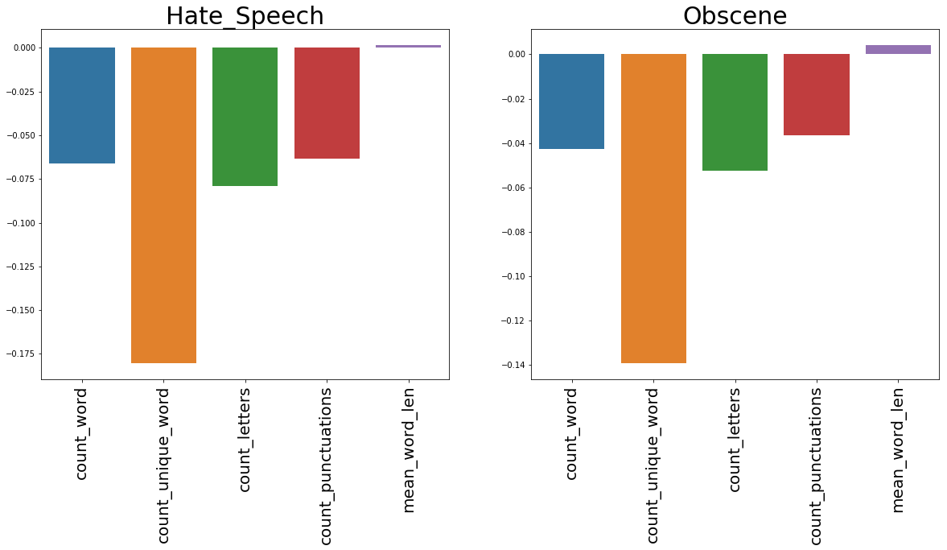
Correlation Between Extracted Features and Target variables with clean Data

Slide 13
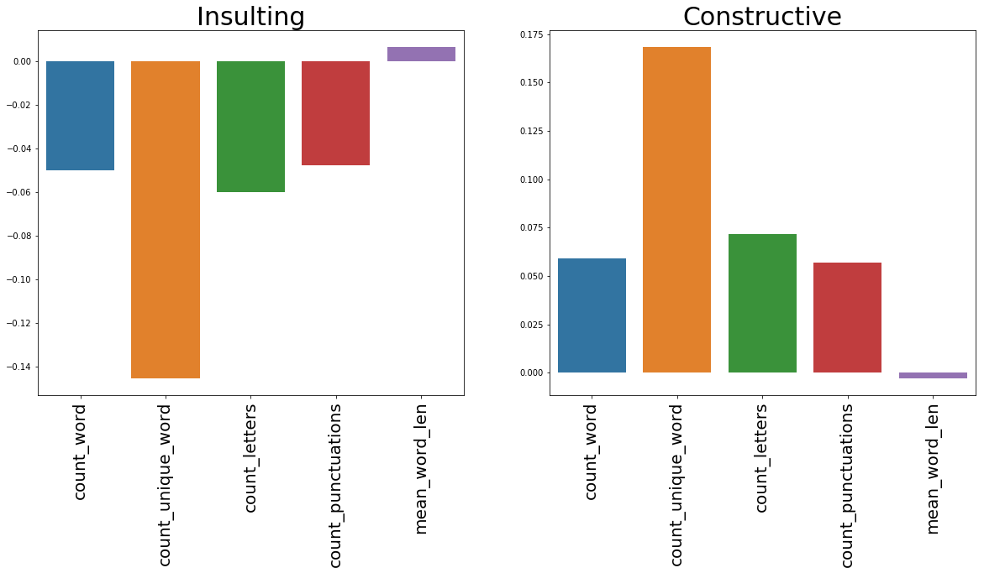
Correlation Between Extracted Features and Target variables with clean Data
From the above four slides its clearly seen that even cleaning the data is not going to effect much on model building but we will be loosing some information in cleaning such as Upper words , special characters.

Slide 14
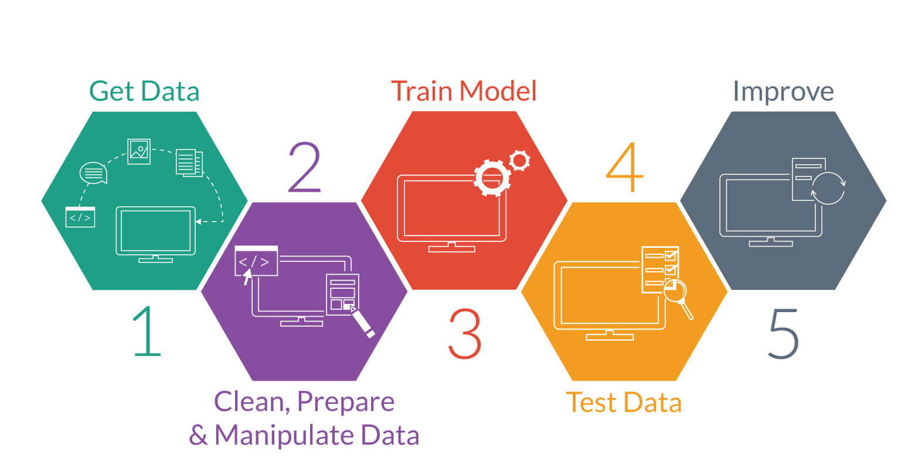
Model Building

Slide 15
Model Building approach 1 multiclass Spam and Ham Detection
MODEL
Text Data Base
Spam
Input
Output
Ham
Spam
Input
Predictions
Spam
Ham
New Data
Spam
Target Labels

Slide 16
Model Building approach 2 multiclass 8 Levels Detection (Label Powerset)
MODEL
Text Data Base
0
1
2
3
4
5
6
7
Input
Output
Input
Predictions
0
1
2
3
4
5
6
7
New Data
Target Labels

Slide 17
Model Building approach 3 with Three labels Multiclass (Binary relevance)
Obscene
Text Data Base
MODEL 1
MODEL 2
MODEL 3
Insulting
Output from every model
Hate Speech
Obscene
Insulting
Hate Speech
Predictions
New Data
Target Labels

Slide 18
Model Building approach 4 with Three labels Multiclass multi label
MODEL
Text Data Base
Obscene
Input
Output
Insulting
Hate
Input
Predictions
Obscene
Insulting
New Data
Hate
Target Labels

Slide 19
SPAM HAM Detection 2 Levels Model approach 1
Spam Ham Detection using:
Initially we can start of to work with the 2level model as model approach 1.
If the data is labelled spam in the place of three classes and constructive messages as ham we can use this model.
By this method we are able to get an accuracy of around .90 and even the recall is pretty nearly .89.
And even this doesn’t serves our model to split the ham further to generate a model to segregate the classes further.

Slide 20
Label powerset 8 levels detection model approach 2
Label Power set:
This method transforms the problem into a multi-class problem where the multi-class labels are essentially all the unique label combinations. In our case here, where there are three labels, Label Powerset would in effect turn this into a 2^3 or 8-class problem. {Thanks Joshua for pointing out.}
The major draw back is that it causing heavy class imbalance due to which the model is not able to learn the minority class values.
Up sampling will also lead to problem of making up a fake comments which will be just a duplicate copy.

Slide 21
Binary relevance Using the simple Logistic Regression Approach 3
Binary Relevance:
This is probably the simplest which treats each label as a separate single classification problems. The key assumption here though, is that there are no correlation among the various labels.
The model performance is good and able to detect the relation between the comments and even the recall is around 0.8788

Slide 22
Multiclass Multilabel Model building approach 4
Different models were tried and the recall for every model is been calculated and further been verified.
LSTM model is giving highest accuracy and GRU is stable on accuracy.

Slide 23
Weighted Recall Comparison on Various Models
Final Model :GRU

Slide 24
Future works to be done
New Data labels to be predicted
DATA
COPY DATA
Index Mapping to
Extract Spam
Make Spam DATA with different levels
Extract Ham data and send to model2
Make Spam Ham DATA
Spam Ham Model 1
Spam Levels Model 2
Labels (Spam & Ham)
Labels (Spam & Ham)
Save the Predictions of model 1 and 2

Slide 25
Q&A

Slide 26
THANK You

